Slide 1

CAPI Module Interviews
Interviewers

Slide 2
What?
Why?
When?
Who?
How?
Beginning individual module interviews using CAPI menus
Simplicity and organization of work; sharing work
After completing household interview and beginning modules
Interviewers
Access the Module Menu within a household interview

Slide 3

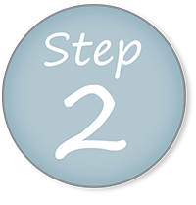
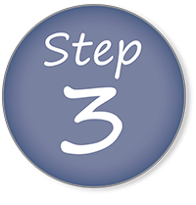
From interviewer main menu, open household interview
Navigate to the Module Menu
Select module to complete and begin interview!

Slide 4
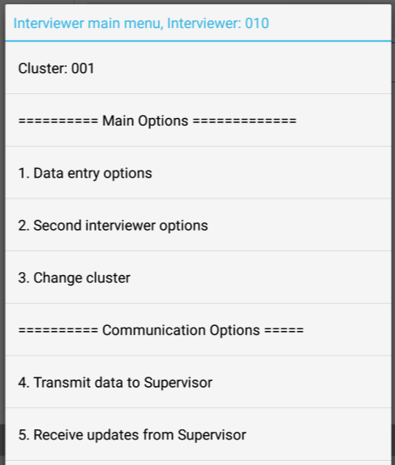
Open household interview
If household interview has been exited after completing Modules 1 and 2, follow these steps!
Notes:
If still in the interview, stay there (no need to exit)

Slide 5
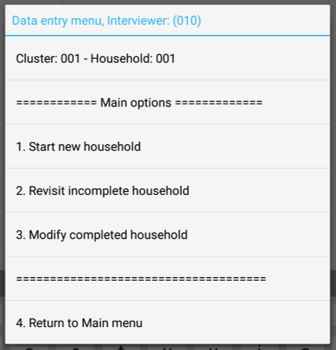
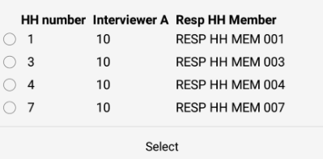
Open household interview
Choose correct household:
Is the household a:
New household? (1)
Incomplete household? (2)
OR a call-back? (2)
Completed household? (3)
Notes:
You can access the modules from a new household, but let’s assume we exited the household after Module 1 and 2…

Slide 6
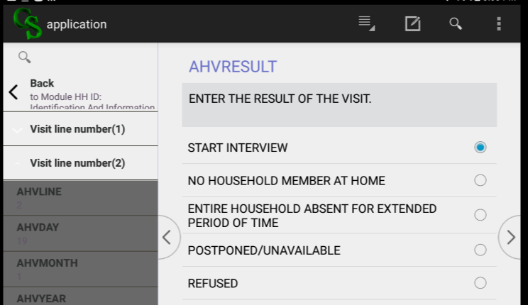

Navigate to Module Menu
Notes:
From any screen, meaning - (i.e. this one if reentering the QRE or the end of module 2 if continuing on…)

Slide 7
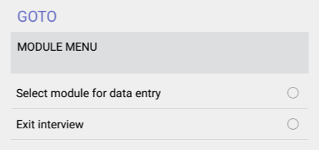
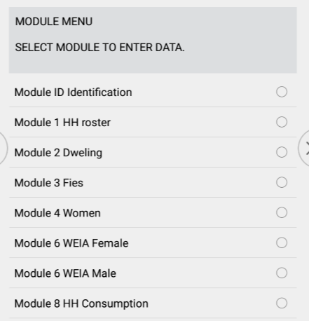

Navigate to Module Menu
Applicable modules only!
Module Menu is also where to exit an interview!

Slide 8
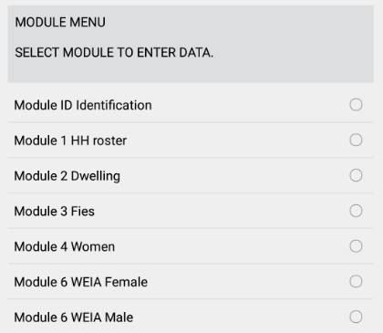

Select module to begin interview
Once desired module is selected, CAPI will jump to first screen in that module
Notes:
ASK: how do we know which modules apply??
ANSWER: Household schedule and Household characteristics (module 7s)

Slide 9
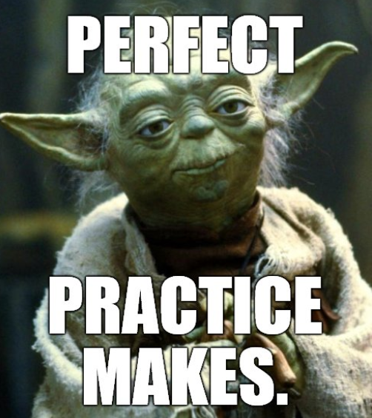
Practice time!
Continue entering data from paper questionnaires, entering data from other modules
Complete all but two modules!
Notes:
Continue practice with entering in CAPI using paper questionnaires. May want to demo more – depends on the comprehension of the class

